Slide 1
Artificial Intelligence
Chapter 7: Logical Agents & Propositional Logic
In which we design agents that can form representations of the world, use a process of inference to derive new representations about the world, and use these new representations to deduce what to do.
Instructor: Zakariya Ahmed Oraibi
University of Basrah, Iraq

Slide 2
What is Knowledge Base (KB)
Logical Agents Combine:
- A Knowledge Base (KB): A list of facts that are known to the
agent.
- Current Percepts.
Thus, KB can be defined as: A set of sentences describing the world.
Motivation: To infer hidden aspects of the current state using Rules of Inference

Slide 3
How to Represent KB?
Logic: It is a formal language to represent knowledge, which consists of:
Which one is more challenging? And why?

Slide 4
How to Represent KB?
Words with more than one meaning:
I left my phone on the left side of the room.
The committee chair sat in the center chair.
- She will park the car so we can walk in the park.

Slide 5
Propositional Logic
The simplest and most abstract logic
A proposition: is a statement that can either be true or false; it must be one or the other but not both.
Example: “9 + 5” , “9 is not a prime number”
An atomic sentence is one whose truth or falsity does not depend on any other proposition.
Note: letters (q, p, O, …) can be used to represent this logic

Slide 6
Syntax

Slide 7
Semantic
- A model specifies the true/ false status of each proposition symbol in the KB.

Slide 8
Semantic Continues..

Slide 9
Semantic Continues..

Slide 10
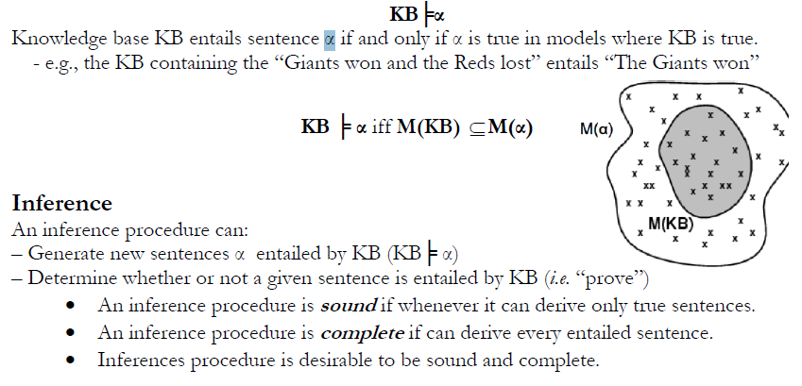
Entailment
- The truth of one sentence follows from the truth of another sentence.

Slide 11
Entailment: Inference

Slide 12
Entailment: Inference
Answer 2: We can use deduction theorem: if KB then a

Slide 13
Inference Rules.. NO TRUTH TABLE
It is a faster way to implement the inference process by using a proof procedure that uses sound rules of inference to deduce (i.e., derive) new sentences that are true in all cases where the premises are true.
Given the sentences in KB, construct a proof that a given conclusion sentence can be derived from KB by applying a sequence of sound inferences using either sentences in KB or sentences derived earlier in the proof, until the conclusion sentence is derived.
This step-by-step, local proof process also relies on the monotonicity property. That is, adding a new sentence to KB does not affect what can be entailed from the original KB and does not invalidate old sentences.

Slide 14
Inference Rules.. MEMORIZE
p

Slide 15
Inference Rules.. MEMORIZE
P q Can be rewritten as:
ⱽ
Because of “Implication Elimination”
ꞀP q
P
1
ⱽ
Ꞁ P q
2
q
3
Using MP Rule
New Rule has been inferenced

Slide 16
Inference Rules.. MEMORIZE
p

Slide 17
Inference Rules.. MEMORIZE
P q Can be rewritten as:
ⱽ
Because of “Implication Elimination”
ꞀP q
ⱽ
Ꞁ P q
1
Ꞁ q
2
Ꞁ P
3
Using MT Rule
New Rule has been inferenced

Slide 18
Inference Rules.. MEMORIZE
p r
p r

Slide 19
Inference Rules.. MEMORIZE
p r
P q Can be rewritten as:
ⱽ
Because of “Implication Elimination”
ꞀP q
q r Can be rewritten as:
ⱽ
Because of “Implication Elimination”
Ꞁq r
ⱽ
Ꞁ P q
1
ⱽ
Ꞁ q r
2
ⱽ
Ꞁ p r
3
Using Syllogism Rule
p r

Slide 20
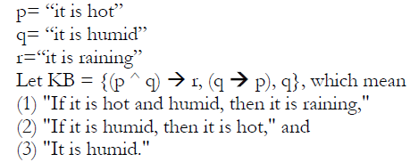
Inference Rules.. Example
Let’s take the weather problem:
Prove the conclusion “is it raining” for
the “weather problem” given above by inference rules.

Slide 21
Inference Rules.. Example
Let’s take the weather problem:
Answer:
1
2
3
4
Modus Ponens (1,2)
5
And Introduction (1,4)
6
Modus Ponens (3,5)
Prove the conclusion “It is raining” for
the “weather problem” given above by inference rules.

Slide 22
Disadvantages of Propositional Logic
Hard to identify "individuals." E.g., Mary, 3. we need a unique symbol for each individual.
Can't directly talk about properties of individuals or relations between individuals. E.g., tall(Bill).
Generalizations can't easily be represented. E.g., all triangles have 3 sides.

Slide 23
Thank You

